Slide 1
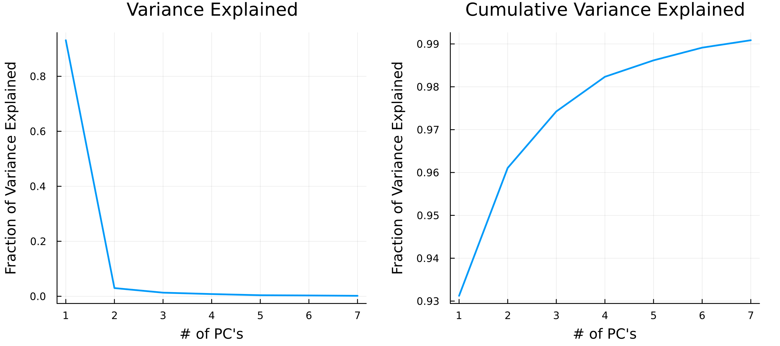
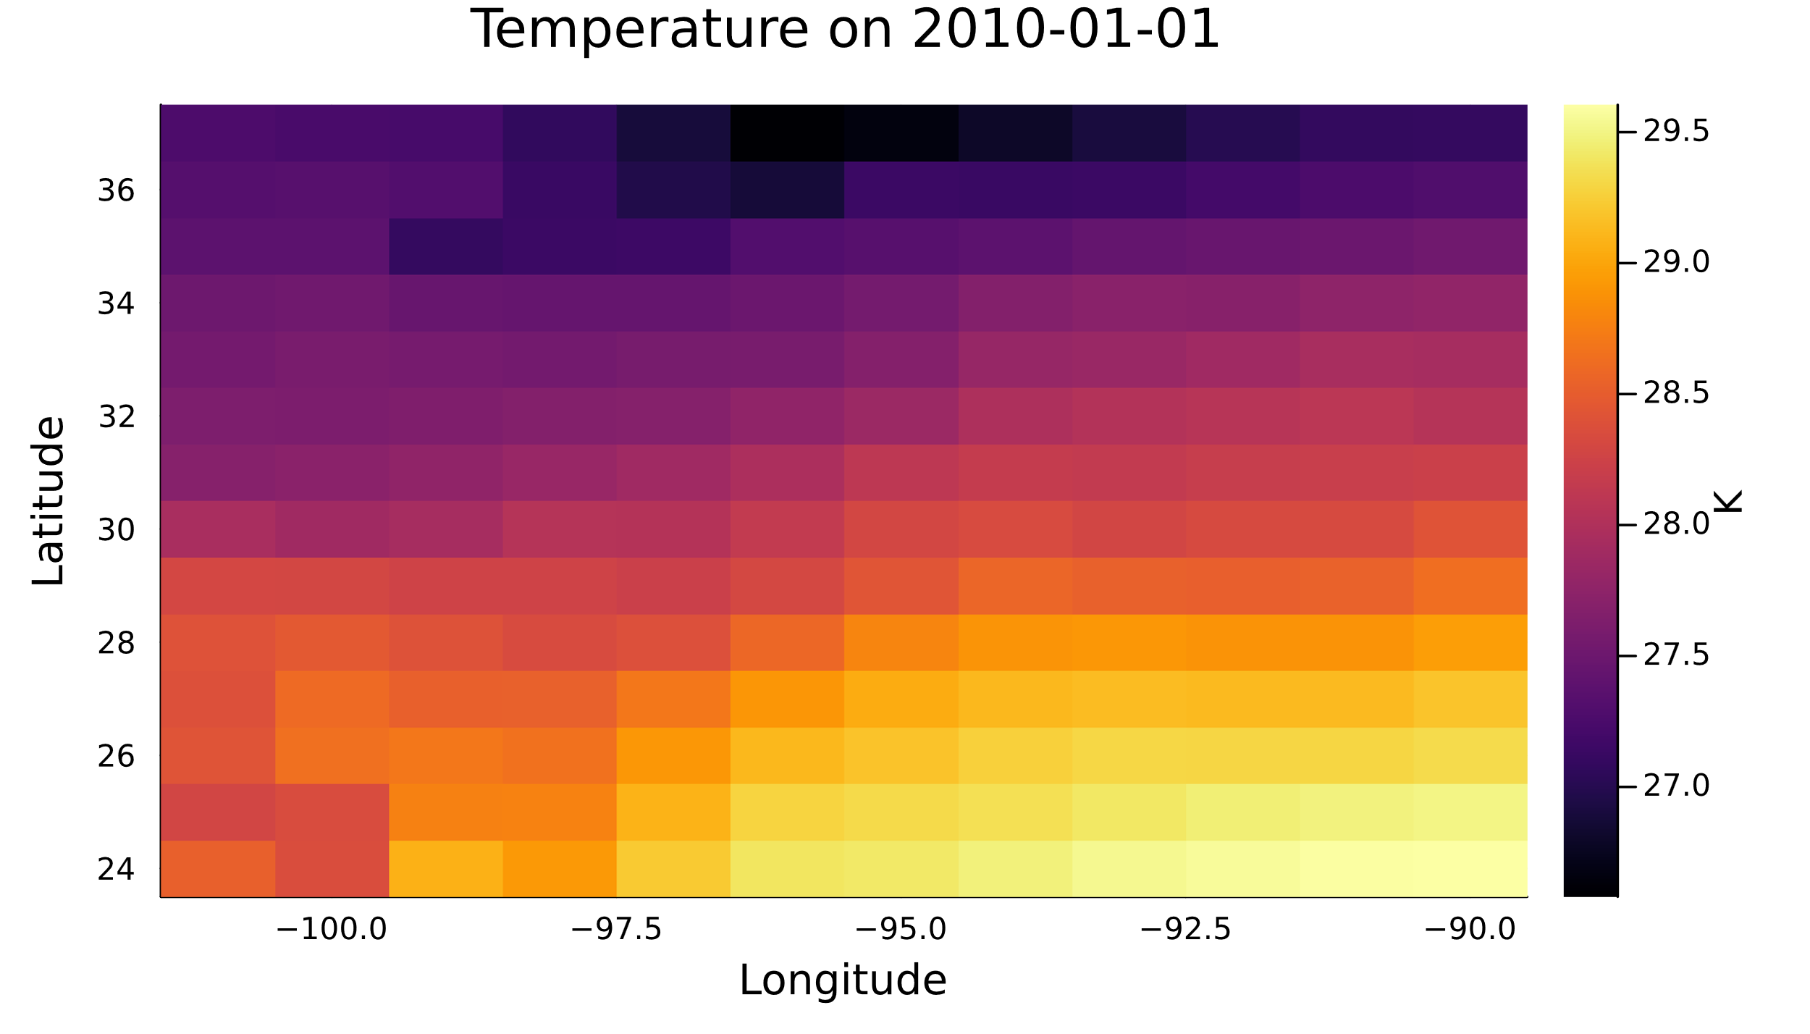
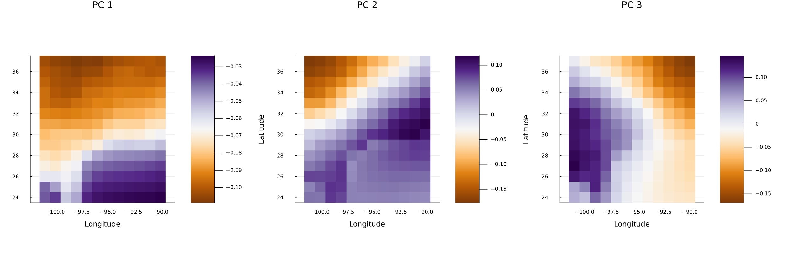
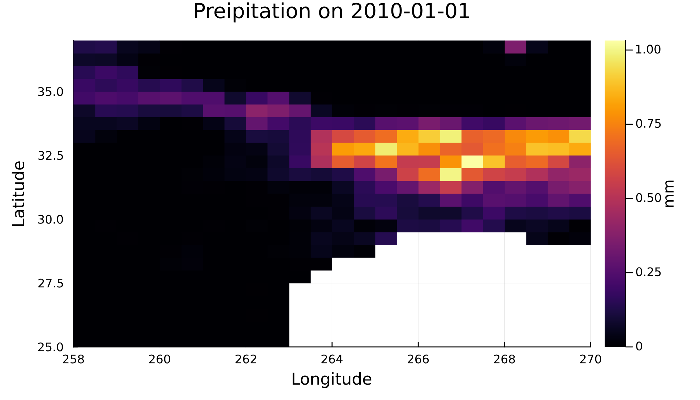
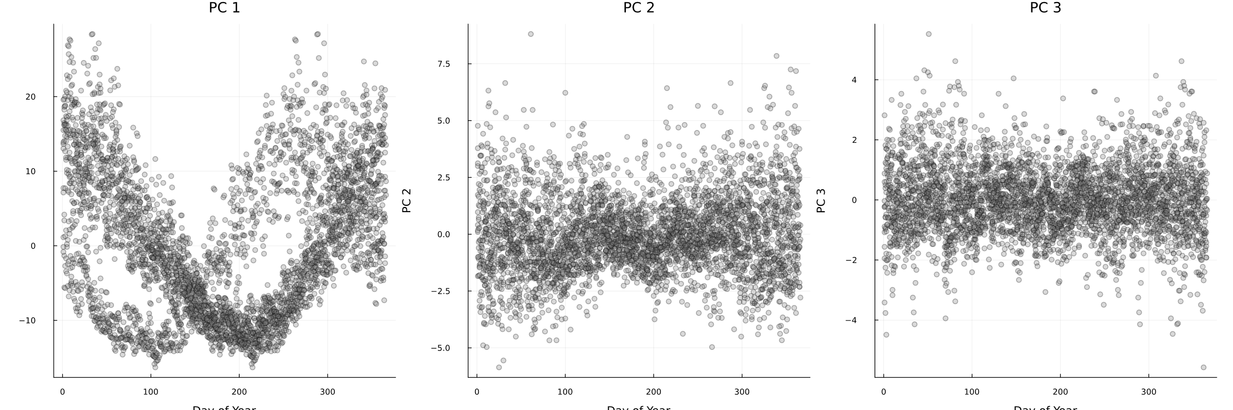
My Data & Preprocessing
Principal Components
My Temp and Precip Data

Slide 2
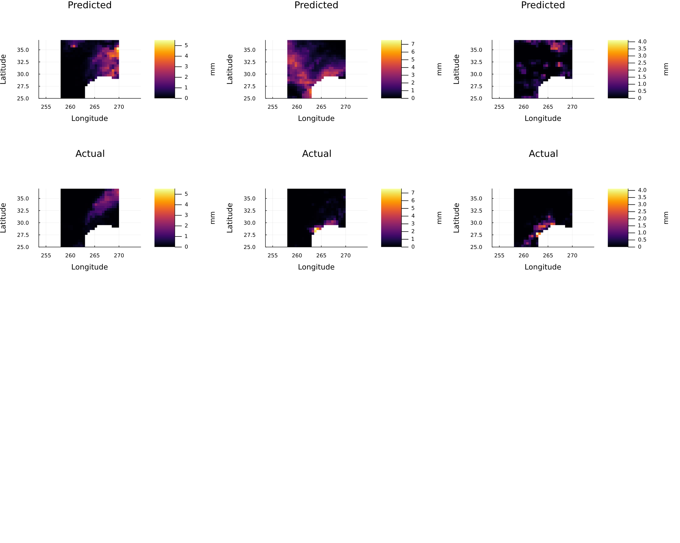
Results of KNN & Model Comparison
Also tried to make Random Forest Model
Not much luck
do believe that my random forest model, if using the original data and not the PCA data, could have been better for my large dataset
think a big reason my KNN model didn’t do great was because there was still some noise from outliers even after choosing my principal components
Because KNN models are sensitive to noise, that noise may have caused my model to struggle.

